Slide 1
Fun with solar
11/30/2016
Github: https://github.com/tobyvessalius/nasaopendataProject
Trello: https://trello.com/b/0PP00J8r/ec601-nasa-project
Xinran Zhang zhangxr@bu.edu
Jiahao Chen tobychen@bu.edu
Heming Huang hemingh@bu.edu
Siyue Wang siyuew@bu.edu
Notes:
1
Hi everyone, my name is Siyue Wang. And they are my teammates, Jiahao Chen, Xinran Zhang, Heming Huang. Our team name is Fun with NASA.
Let’s first have a basic review of our project. Our project is using NASA open data and data provided by NREL which is National Renewable Energy Laboratory. And by analyze those data, we provide our evaluation for our users whether a place is suitable for building solar power plants or not.

Slide 2
System Diagram
*
NREL
Open Data
NASA
Visualization
Database
MongoDB
Evaluation System
Data Analyses
JavaScript
HTML
Web Application
CSS
2
Notes:
Here is our system diagram. In our project, we mainly use the data provided by the NREL(National Renewable Energy Laboratory). NASA open data is also an important resource of our project. We download the data of each region we needed and upload the processed version of the data to our MongoDB. What’s important I want to mention that is in our last last sprint, we just create our database, And by this sprint, we have successfully added the visualization part to our database which gives our users a clear and direct overview of the data to each location.
By using our evaluation system for our data, we eventually show our result in our web application. Our web application is built using HTML, JavaScript and CSS.
MongoDB is a free and open-source cross-platform document-oriented database program. Classified as a NoSQL database program, MongoDB uses JSON-like documents with schemas.

Slide 3
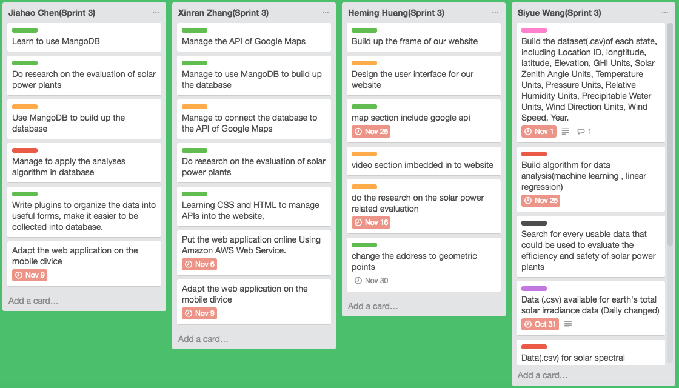
Trello Sprint 3 Diagram
*
3
Notes:
Here is our Sprint 3 Diagram on Trello. As we can see from the trello, we separate our project to data processing, database and web part. And after sprint 2, by working on each concrete part of our project, our team accomplished most part we planed to finish before this sprint.

Slide 4
Accomplishments
*
Process our data region by region using python
Add time variation to each location
Build up MongoDB database
Operate and insert large amount of data to MongoDB database using windows script
Connecting MongoDB database to RoboMongo in order to view data in a more straightforward way
Data visualization
4
Notes:
As we already have the great open data provided by NREL and NASA. Before this sprint, We not only successfully processing the data region by region, but also add time variation to each location by 30 min. so we can see how each elements in our databased changes through time variation and also it increase the accuracy of our evaluation to our data and give our users a better overview.

Slide 5
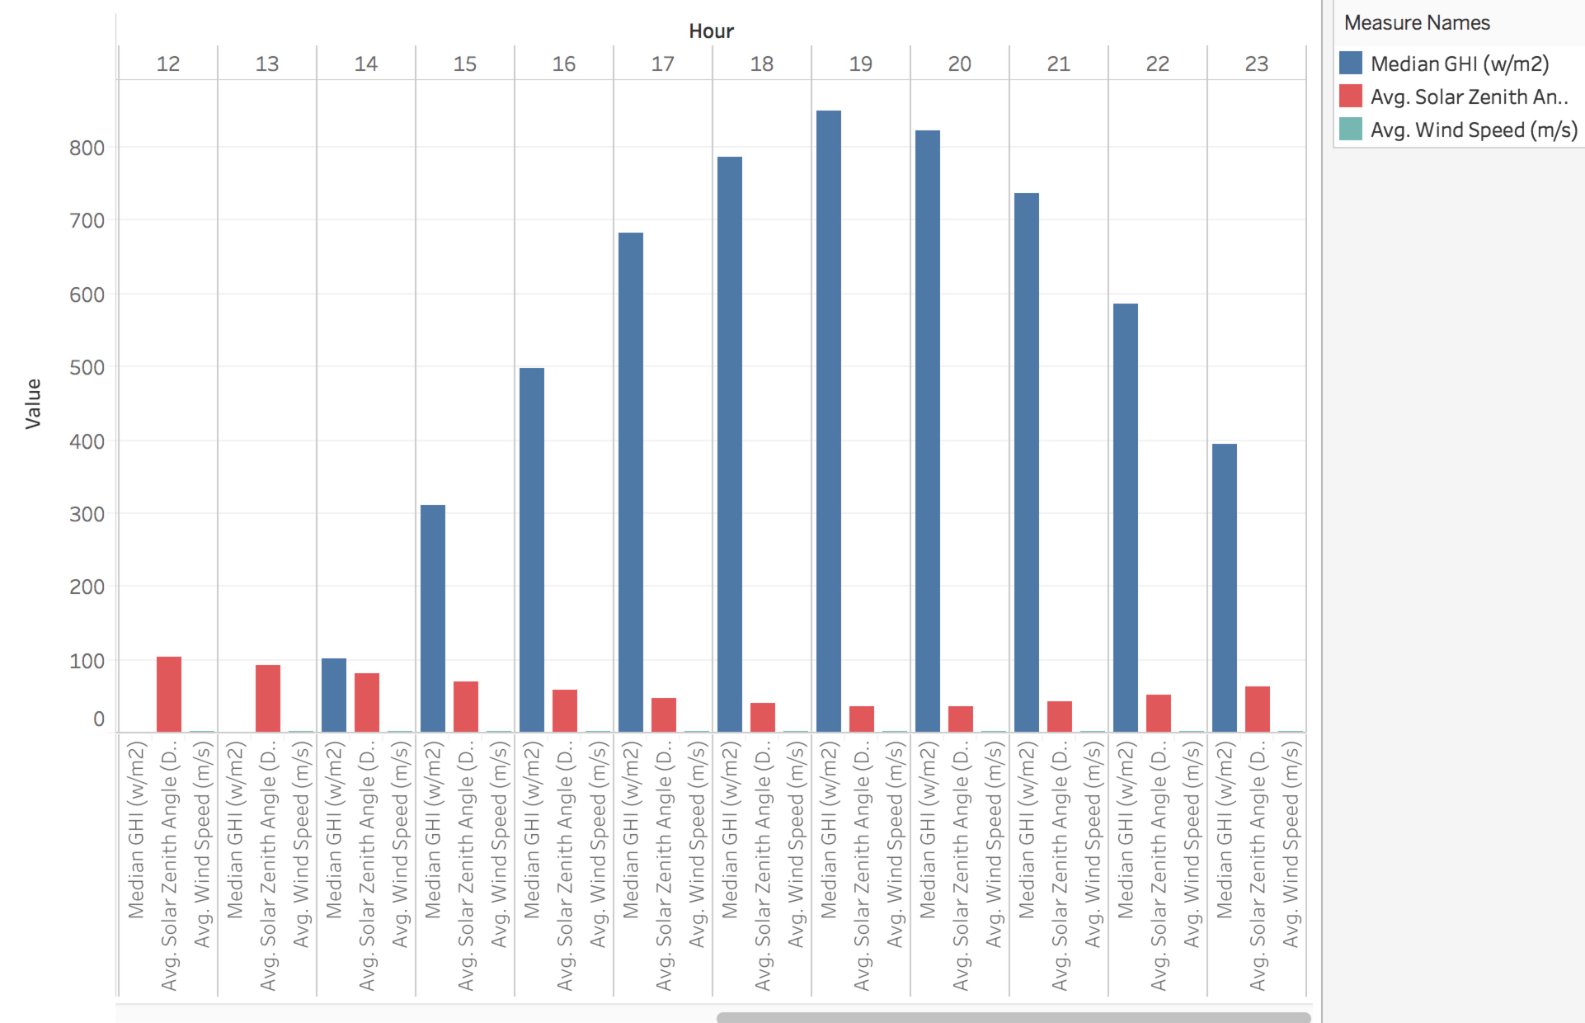
Visualization
*
5
Notes:
Here are three main elements we take into consideration for our Visualization, median GHI, average Solar zenith angle and average wind speed. The median GHI stands for the median Global Horizontal Irradiance ,which is the total amount of shortwave radiation received from above by a surface horizontal to the ground. The solar zenith angle is the altitude of the sun, the angle between the horizon and the centre of the sun's disc. Wind speed is essential to the safety of solar power plants . This is only the basic realization of our visualization part, we will finish it and adding more factors before sprint 4.

Slide 6
DEMO
*
https://youtu.be/HQu_kA1rquQ
https://d3e7otyrj2qhlb.cloudfront.net/
6

Slide 7
Challenges
*
Things that we are not yet accomplished?
Connecting our database with our Visualization Tools
Figure out better ways to evaluate the data that been used.
Connect our database to web application.
How to display our data in a more direct way through time variation
7
Notes:
Ex. Adding more impact factors to our data analysis system.

Slide 8
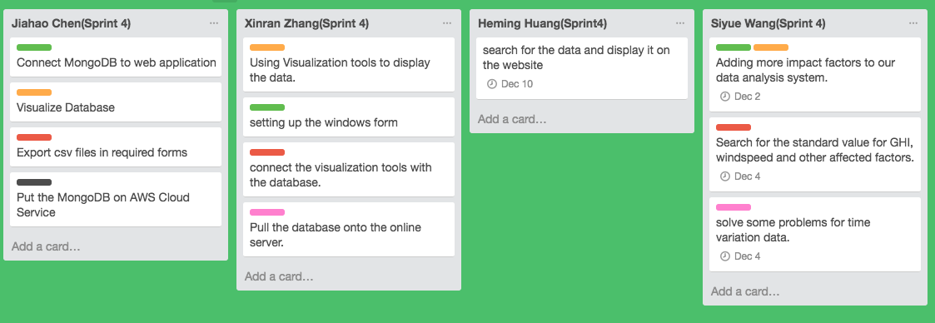
Sprint 4 Plan
*
8

Slide 9
THANK YOU
*
9

